Slide 1
Chapter-4
Combinatinal Logic
Chapter 4 <number>

Slide 2
Overview
Introduction of combinational circuits
Design Procedure
Binary adders
  Half and full adders
Binary subtractors
Code Conversion
Analysis Procedure
Chapter 4 <number>

Slide 3
Combinational Logic
Use the Boolean Algebra and the
minimization techniques to design useful
circuits
• No feedback, no memory
• Just n inputs, m outputs and an arbitrary truth
table
Chapter 4 <number>

Slide 4
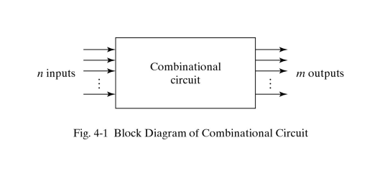
Block Diagram of a Combinational Circuit
Chapter 4 <number>

Slide 5
Design Procedure
Give short names to all inputs and outputs
• Derive truth table from the specification
• Simplify
• Draw diagram
Chapter 4 <number>

Slide 6
Functional Blocks: Addition
Binary addition used frequently
Addition Development:
  Half-Adder (HA), a 2-input bit-wise addition functional block,
  Full-Adder (FA), a 3-input bit-wise addition functional block,
  Ripple Carry Adder, an iterative array to perform binary addition, and
  Carry-Look-Ahead Adder (CLA), a hierarchical structure to improve performance.
Chapter 4 <number>

Slide 7
Functional Block: Half-Adder
A 2-input, 1-bit width binary adder that performs the following computations:
A half adder adds two bits to produce a two-bit sum
The sum is expressed as a sum bit , S and a carry bit, C
The half adder can be specified as a truth table for S and C ⇒
X
0
0
1
1
+ Y
+ 0
+ 1
+ 0
+ 1
C S
0 0
0 1
0 1
1 0
X
Y
C
S
0
0
0
0
0
1
0
1
1
0
0
1
1
1
1
0
Chapter 4 <number>

Slide 8
Logic Simplification: Half-Adder
The K-Map for S, C is:
This is a pretty trivial map!
By inspection:
and
These equations lead to several implementations.
S
Y
C
Y
1
0
1
0
1
X
1
X
1
S
=
X
⋅
Y
+
X
⋅
Y
=
X
⊕
Y
2
3
2
3
C
=
X
⋅
Y
C
=
(
(
X
⋅
Y
)
)
Chapter 4 <number>

Slide 9
Five Implementations: Half-Adder
We can derive following sets of equations for a half-adder:
(a), (b), and (e) are SOP, POS, and XOR implementations for S.
In (c), the C function is used as a term in the AND-NOR implementation of S, and in (d), the function is used in a POS term for S.
(
a
)
S
=
X
⋅
Y
+
X
⋅
Y
(
d
)
S
=
(
X
+
Y
)
⋅
C
C
=
X
⋅
Y
C
=
(
X
+
Y
)
(
b
)
S
=
(
X
+
Y
)
⋅
(
X
+
Y
)
(
e
)
S
=
X
⊕
Y
C
=
X
⋅
Y
C
=
X
⋅
Y
(
c
)
S
=
(
C
+
X
⋅
Y
)
C
=
X
⋅
Y
C
Chapter 4 <number>

Slide 10
Implementations: Half-Adder
The most common half adder implementation is: (e)
A NAND only implementation is:
X
S
Y
S
=
X
⊕
Y
C
C
=
X
⋅
Y
C
X
S
=
(
X
+
Y
)
⋅
C
C
=
(
(
X
⋅
Y
)
)
S
Y
Chapter 4 <number>

Slide 11
Functional Block: Full-Adder
A full adder is similar to a half adder, but includes a carry-in bit from lower stages. Like the half-adder, it computes a sum bit, S and a carry bit, C.
  For a carry-in (Z) of 0, it is the same as the half-adder:
  For a carry- in
  (Z) of 1:
Z
0
0
0
0
X
0
0
1
1
+ Y
+ 0
+ 1
+ 0
+ 1
C S
0
0
0 1
0 1
1 0
Z
1
1
1
1
X
0
0
1
1
+ Y
+ 0
+ 1
+ 0
+ 1
C S
0 1
1 0
1 0
1
1
Chapter 5 <number>

Slide 12
Logic Optimization: Full-Adder
Full-Adder Truth Table:
Full-Adder K-Map:
X
Y
Z
C
S
0
0
0
0
0
0
0
1
0
1
0
1
0
0
1
0
1
1
1
0
1
0
0
0
1
1
0
1
1
0
1
1
0
1
0
1
1
1
1
1
S
Y
C
Y
1
1
1
0
1
3
2
0
1
3
2
X
1
1
X
1
1
1
4
5
7
6
4
5
7
6
Z
Z
Chapter 4 <number>

Slide 13
Equations: Full-Adder
From the K-Map, we get:
The S function is the three-bit XOR function (Odd Function):
The Carry bit C is 1 if both X and Y are 1 (the sum is 2), or if the sum is 1 and a carry-in (Z) occurs. Thus C can be re-written as:
The term X·Y is carry generate.
The term X⊕Y is carry propagate.
S
=
X
Y
Z
+
X
Y
Z
+
X
Y
Z
+
X
Y
Z
C
=
X
Y
+
X
Z
+
Y
Z
S
=
X
⊕
Y
⊕
Z
C
=
X
Y
+
(
X
⊕
Y
)
Z
Chapter 4 <number>

Slide 14
Implementation: Full Adder
Ai
Bi
Full Adder Schematic
Here X, Y, and Z, and C
(from the previous pages)
are A, B, C_{i} and C_{o},
respectively. Also,
G = generate and
P = propagate.
Note: This is really a combination
of a 3-bit odd function (for S)) and
Carry logic (for C_{o}):
(G = Generate) OR (P =Propagate AND C_{i} = Carry In)
Co = G + P · Ci
Gi
Pi
Ci
Ci+1
Si
Chapter 4 <number>

Slide 15
Binary Adders
To add multiple operands, we “bundle” logical signals together into vectors and use functional blocks that operate on the vectors
Example: 4-bit ripple carry
adder: Adds input vectors A(3:0) and B(3:0) to get
a sum vector S(3:0)
Note: carry out of cell i
becomes carry in of cell
i + 1
Description
Subscript
Name
3 2 1 0
Carry In
0 1 1 0
Ci
Augend
1 0 1 1
Ai
Addend
0 0 1 1
Bi
Sum
1 1 1 0
Si
Carry out
0 0 1 1
Ci+1
Chapter 4 <number>

Slide 16
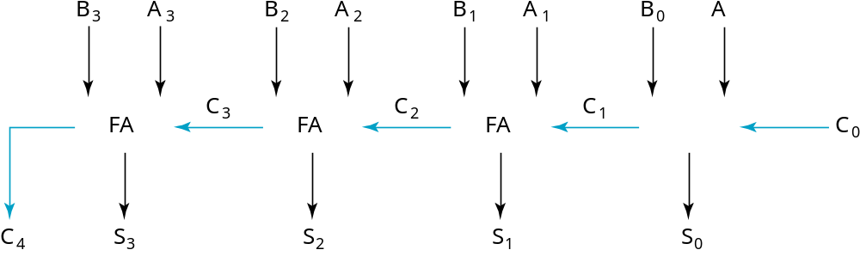
4-bit Ripple-Carry Binary Adder
A four-bit Ripple Carry Adder made from four 1-bit Full Adders:
Chapter 4 <number>

Slide 17
Carry Propagation & Delay
One problem with the addition of binary numbers is the length of time to propagate the ripple carry from the least significant bit to the most significant bit.
The gate-level propagation path for a 4-bit ripple carry adder of the last example:
Note: The "long path" is from A₀ or B₀ though the circuit to S₃.
A3
A2
A1
A0
B3
B2
B1
B0
C3
C2
C1
C0
C4
S3
S2
S1
S0
Chapter 4 <number>
Notes:
It is possible to create a logical circuit using multiple full adders to add N-bit numbers. Each full adder inputs a C_{in}, which is the C_{out} of the previous adder. This kind of adder is called a ripple-carry adder, since each carry bit "ripples" to the next full adder.

Slide 18
Carry Lookahead
Given Stage i from a Full Adder, we know that there will be a carry generated when A_{i} = B_{i} = "1", whether or not there is a carry-in.
Alternately, there will be a carry propagated if the “half-sum” is "1" and a
carry-in, C_{i} occurs.
These two signal conditions are called generate, denoted as G_{i}, and propagate, denoted as P_{i} respectively and are identified in the circuit:
Ai
Bi
Gi
Pi
Ci
Ci+1
Si
Chapter 4 <number>

Slide 19
Carry Lookahead (continued)
In the ripple carry adder:
  Gi, Pi, and Si are local to each cell of the adder
  Ci is also local each cell
In the carry lookahead adder, in order to reduce the length of the carry chain, Ci is changed to a more global function spanning multiple cells
Defining the equations for the Full Adder in term of the P_{i} and G_{i}:
P
=
A
⊕
B
G
=
A
B
i
i
i
i
i
i
S
=
P
⊕
C
C
=
G
+
P
C
i
i
i
i
+
1
i
i
i
Chapter 4 <number>

Slide 20
Carry Lookahead Development
C_{i+1} can be removed from the cells and used to derive a set of carry equations spanning multiple cells.
Beginning at the cell 0 with carry in C₀:
C1 = G0 + P0 C0
C2 = G1 + P1 C1 = G1 + P1(G0 + P0 C0)
= G1 + P1G0 + P1P0 C0
C3 = G2 + P2 C2 = G2 + P2(G1 + P1G0 + P1P0 C0)
= G2 + P2G1 + P2P1G0 + P2P1P0 C0
C4 = G3 + P3 C3 = G3 + P3G2 + P3P2G1
+ P3P2P1G0 + P3P2P1P0 C0
Chapter 4 <number>

Slide 21
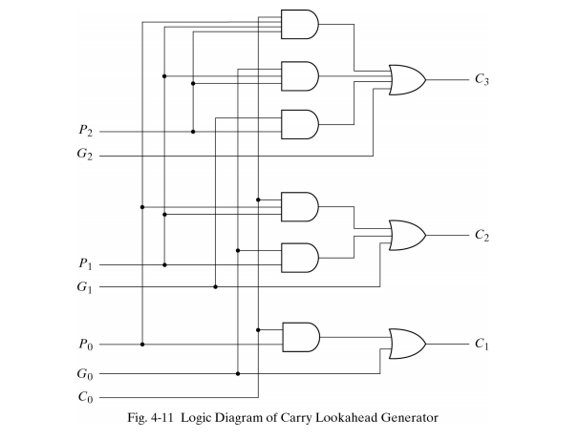
Logic Diagram of Carry Lookahead Generator
Chapter 4 <number>

Slide 22
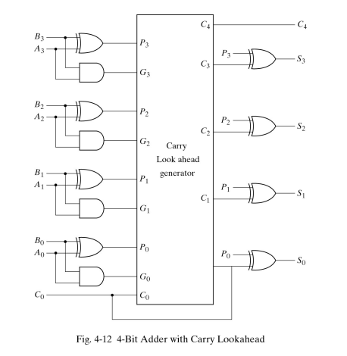
4-Bit Adder with Carry Lookahead
Chapter 4 <number>

Slide 23
Group Carry Lookahead Logic
Figure 5-6 in the text shows shows the implementation of these equations for four bits. This could be extended to more than four bits; in practice, due to limited gate fan-in, such extension is not feasible.
Instead, the concept is extended another level by considering group generate (G₀₋₃) and group propagate (P₀₋₃) functions:
Using these two equations:
Thus, it is possible to have four 4-bit adders use one of the same carry lookahead circuit to speed up 16-bit addition
G
=
G
+
P
G
+
P
P
G
+
P
P
P
P
G
0
−
3
3
3
2
3
2
1
3
2
1
0
0
P
=
P
P
P
P
0
−
3
3
2
1
0
C
=
G
+
P
C
4
0
−
3
0
−
3
0
Chapter 4 <number>

Slide 24
Code Conversion
It is sometimes necessary to use the output
Of one system as the input to another.
A conversion circuit must be inserted between the two systems if each uses different codes for the same information.
Thus, a code converter is a circuit that makes the 2 systems compatible even though each uses a different binary code.
Chapter 4 <number>

Slide 25
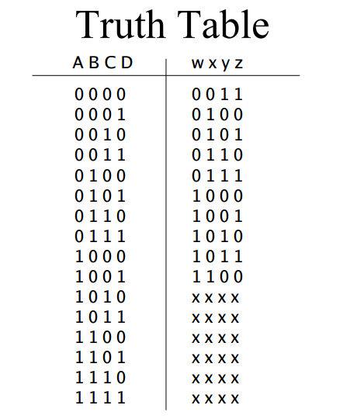
BCD to Excess-3
Chapter 4 <number>

Slide 26
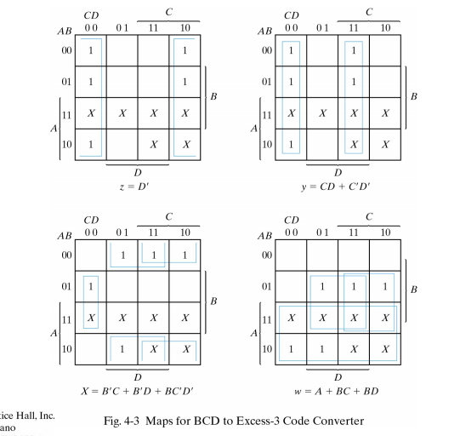
Continue..
Chapter 4 <number>

Slide 27
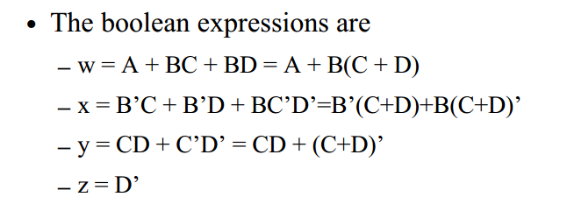
Continue...
Chapter 4 <number>

Slide 28
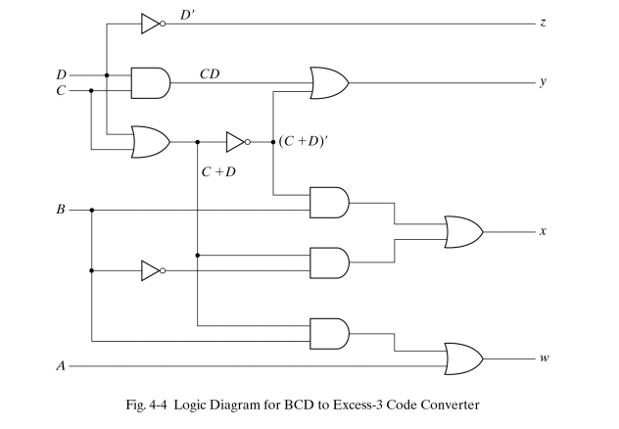
Logic Circuit of BCD to Excess-3
Chapter 4 <number>

Slide 29
Analysis Procedure
We need to analyze digital circuits to verify our designs (as well as understand designs without documentation)
Assume we have the logic diagram (and some minimal info about the inputs)
Chapter 4 <number>

Slide 30
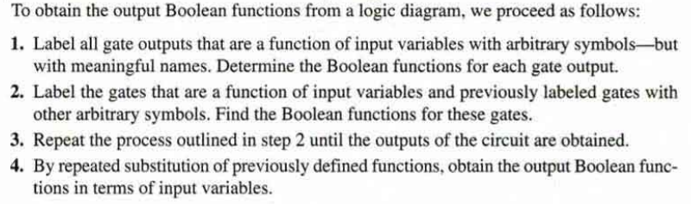
Steps in Analysis
Chapter 4 <number>

Slide 31
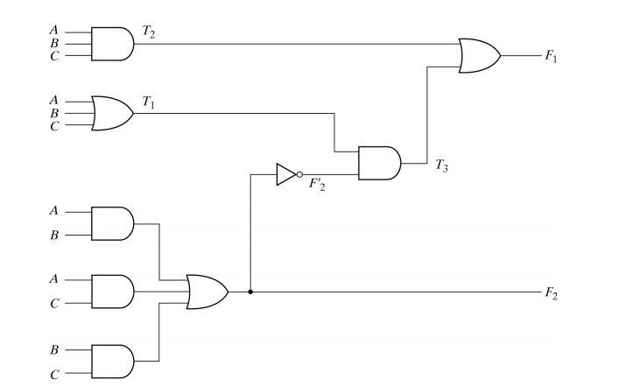
Chapter 4 <number>

Slide 32
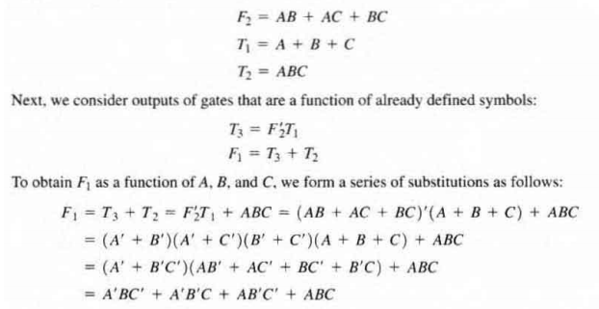
Boolean Functions....
Chapter 4 <number>

Slide 33
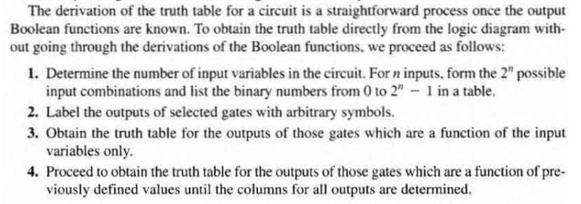
Chapter 4 <number>

Slide 34
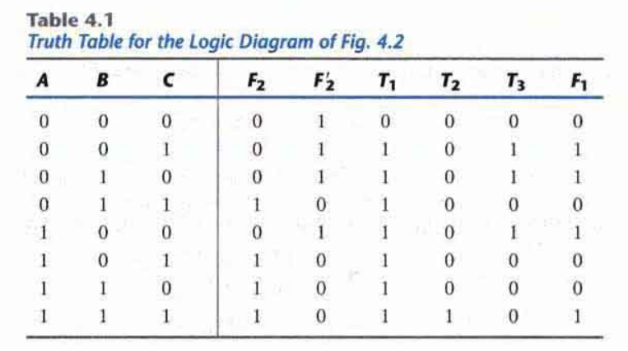
Chapter 4 <number>

Slide 35
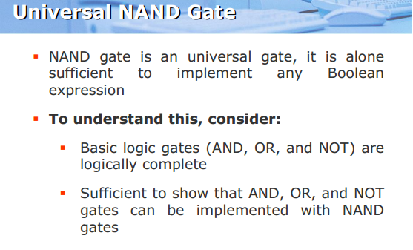
Universal Gate
Chapter 4 <number>

Slide 36
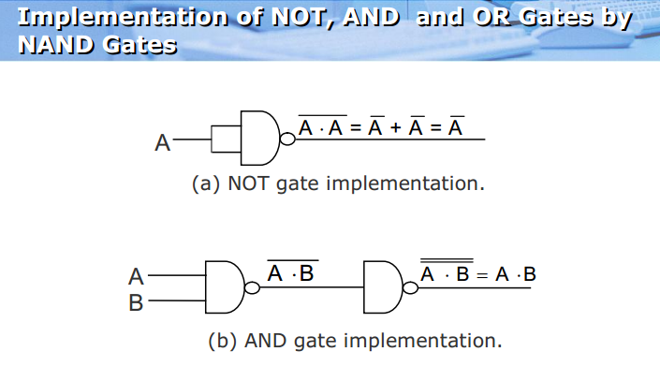
Chapter 4 <number>

Slide 37
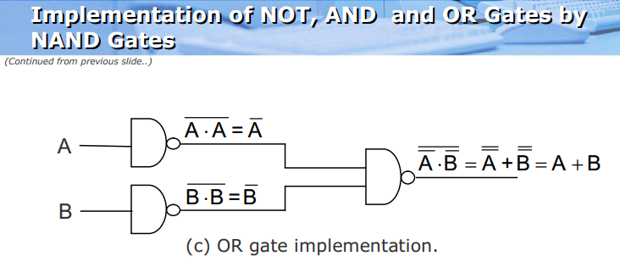
Chapter 4 <number>

Slide 38
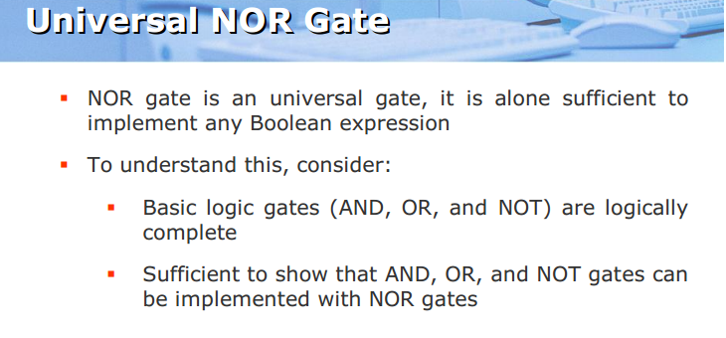
Chapter 4 <number>

Slide 39
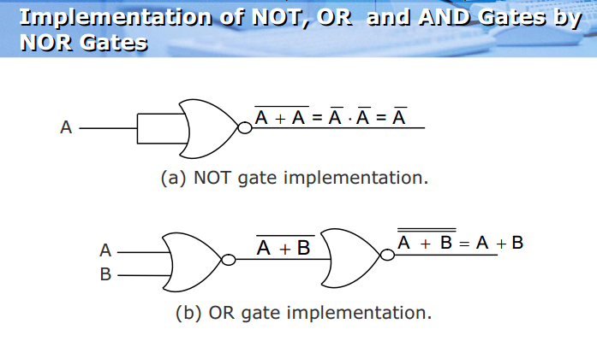
Chapter 4 <number>

Slide 40
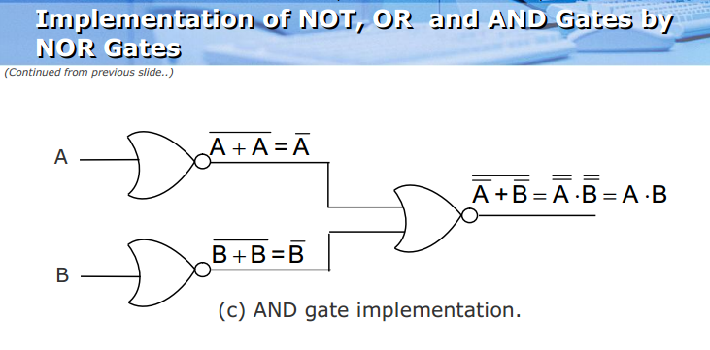
Chapter 4 <number>

